Slide 1

Customer Shopping Behavior Analysis
Uncovering insights from transactional data to drive strategic business decisions.

Slide 2


Project Overview & Goals
Analyze Purchases
Uncover Insights
3,900 transactions across categories.
Spending patterns, segments, preferences.
Guide Decisions
Optimize strategy, future-proof business.

Slide 3

Dataset Summary
Key Features
Customer demographics
Purchase details
Shopping behavior
Data Volume
3,900 Rows
18 Columns

Slide 4
Exploratory Data Analysis (Python)
01
02
03
Data Loading & Exploration
Missing Data Handling
Column Standardization
Imported with pandas, checked structure and statistics.
Imputed Review Rating using median.
Renamed to snake_case for readability.
04
05
Feature Engineering
Database Integration
Created age_group and purchase_frequency_days.
Loaded cleaned data to PostgreSQL.

Slide 5
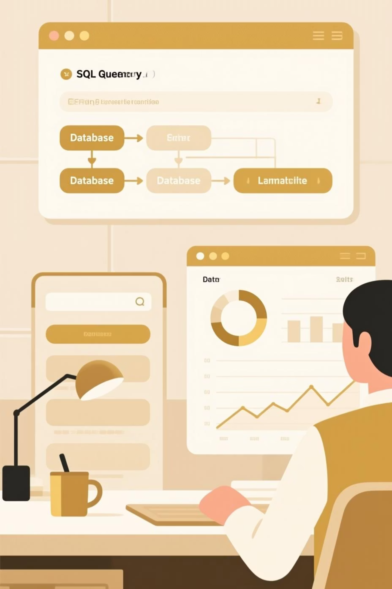
SQL Analysis: Key Business Questions
Revenue by Gender
Female: $75,191 | Male: $157,890
High-Spending Discount Users
Identified 839 customers.
Top 5 Products by Rating
Gloves, Sandals, Boots, Hat, Skirt.
Shipping Type Comparison
Standard: $58.46 | Express: $60.48

Slide 6
SQL Analysis: Deeper Insights
1
2
3
Subscribers vs. Non-Subscribers
Discount-Dependent Products
Customer Segmentation
Loyal (3,116), Returning (701), New (83).
Subscribers: 1,053, Avg Spend $59.49. Non-Subscribers: 2,847, Avg Spend $59.87.
Hat (50%), Sneakers (49.66%), Coat (49.07%).
4
5
Repeat Buyers & Subscriptions
Revenue by Age Group
958 repeat buyers are subscribers.
Young Adult: $62,143, Senior: $55,763.

Slide 7
Top Products by Category
1
Accessories
Jewelry
171
2
Accessories
Sunglasses
161
3
Accessories
Belt
161
1
Clothing
Blouse
171
2
Clothing
Pants
171
3
Clothing
Shirt
169
1
Footwear
Sandals
160
2
Footwear
Shoes
150
3
Footwear
Sneakers
145
1
Outerwear
Jacket
163
2
Outerwear
Coat
161

Slide 8
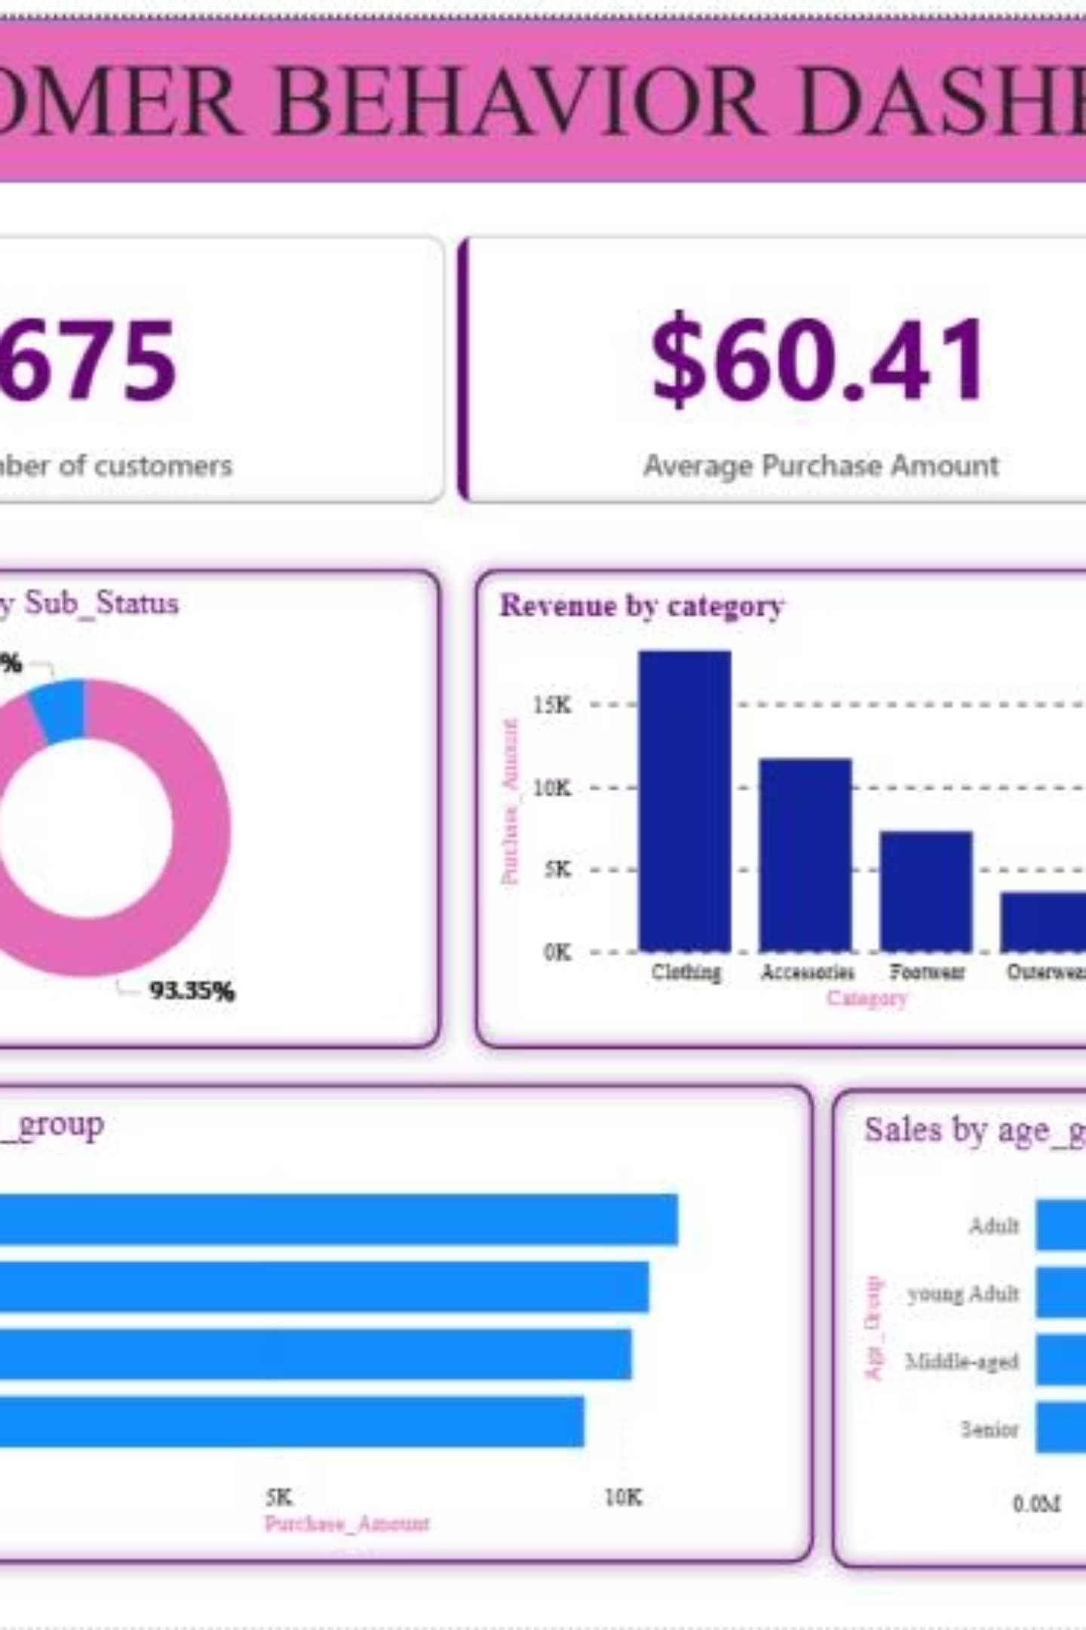
Interactive Dashboard in Power BI
Visualizing customer behavior for actionable insights.

Slide 9
Business Recommendations
Boost Subscriptions
Promote exclusive benefits.
Customer Loyalty Programs
Reward repeat buyers.
Review Discount Policy
Balance sales with margin control.
Product Positioning
Highlight top-rated and best-selling items.
Targeted Marketing
Focus on high-revenue age groups and express shipping users.

Slide 10

Driving Growth Through Data
Leveraging insights to optimize customer experience and maximize revenue.

